Slide 1
OQCELLCCS – QPLANT tender
QPLANT – ACR – TR – Gerkotze Bonthuys - 27/11/2024

Slide 2
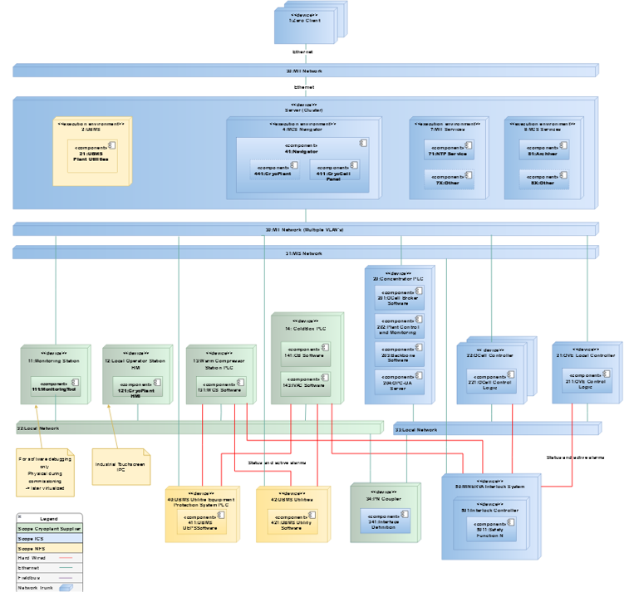
Document Elements (addendum for granting phase
Items Snapshot 2024-w49 (2024/12/03)
RFO Update – Total Document - (Granting Phase – Publication of RFO pre negotiation)
PILLARS
Requirements MATRIX (RM_QPLANT)
Requirements
IMS (Seek integrated management plant – ISO 9001 for quality
Control Systems
Deliverables required (conceptual design, RFO) for Controls
Notes:
more photo’s available on imagebank.sckcen.be

Slide 3
Status
Document
RFO Update (Granting Phase – Publication of RFO pre negotiation)
Collaboration – How we expect to work (should requirements | Move items away from explicit numbered and tracked items to expected working arrangement
Meetings, progress reports, intermediate (working file preview and comment), deliverable review, etc.
RFO SCK CEN Deliverable List
Requirements MATRIX (RM_QPLANT)
Requirements
QM of design and execution (PEP) – Design (performance, constraint, testing, testing methodology, conformance, compliance | Integrated Management System
IMS (Seek integrated management plant – ISO 9001 for quality
PM – Phase based according to lifecycle (Concept, Basic, Detailed, Construction (purchasing, assembly, manufacture), FAT, Transport, Installation, Hook-up, pre-commissioning (total system integration), commissioning, performance testing
Technical
Control Architecture Update, Deliverables required (conceptual design
Interface CCS, MCS
Concentrator on side of MCS
Test Plan, Milestones, Integration Input (TBD)
Notes:
more photo’s available on imagebank.sckcen.be

Slide 4
Status
Granting Action
Granting Document (parent of addendum)
SLA
Software maintenance
Software integration
Hardware maintenance
Subcontractor expected participation
USAGE INTEGRATE COMMSSIONING WITH “LIVE” SYSTEM
2 years service (process and soft)
Optional later
Technical
Integration QCELL commissioning
Differed performance testing
Strategy for options and negotiations
Technical lifecycle options to be included in Granting RFO
Known elements can then be removed as scope reduction
E.g. Gas Purification, Helium Recovery, Warm gas panel, Warm storage (pure, and dirty), helium bottle filling/loading.
Recovery Compressor and Gas Ballast
N+1 Sizing (HP compressors, PVPS how)
Notes:
more photo’s available on imagebank.sckcen.be

Slide 5
Strategy for options and negotiations
Lever for QPLANT Design
Technical lifecycle options to be included in Granting RFO
Might not be part of QPLANT tender, but might be part of QPLANT total lifecycle
Initial thoughts
Gas Purification, Helium Recovery, Warm gas panel, Warm storage (pure, and dirty), helium bottle filling/loading.
MAC PS (future) user
Change in operating philosophy
W line (LP) to Refrigeration | As per current
S line (LP) to Recovery | As per future
Restart of warm CAV to join operational cold
need QINFRA adjustment 1 more supply (cold) and possible warm insulation
50 k€ per line
Insulated (200 k€)
Cost additional = 250 k€
Recovery Compressor and Gas Ballast
Integrates with gas purification
LOOP accident analyses
Needs space reservation in CCB
N+1 Sizing (HP compressors, PVPS)
Possible future MYRRHA requirement – space reservation, integration and cost needed
Split box (QLR and SPLIT box) – Estimate integration activities (learn from them how they would do it)
Input into QDB tender, execution and technical progress – gives (early) indication of impact of TS and routing for MYRRHA
Notes:
more photo’s available on imagebank.sckcen.be

Slide 6
Strategy for options and negotiations
Lever for QPLANT Design
Known elements can then be removed as scope reduction
E.g. Gas Purification, Helium Recovery, Warm gas panel, Warm storage (pure, and dirty), helium bottle filling/loading.
Recovery Compressor and Gas Ballast
N+1 Sizing (HP compressors, PVPS how)
Notes:
more photo’s available on imagebank.sckcen.be

Slide 7
Project Requirements
Energy Driver – Local|External
Local
QPLANT
ACR
ACC NF
External
LINAC, MINERVA (Primary User of QSYST for 2K RF CELL operation)
SCK CEN (PUR, IDPBW)
Notes:
more photo’s available on imagebank.sckcen.be

Slide 8
RFO Update – Total Document - (Granting Phase – Publication of RFO pre negotiation)
Requirements MATRIX (RM_QPLANT)
CIS review (100 of ~530 Requirements)
Answer, review, update
Linked to IMS in PEP (GBO to propose ISO 27001, and 16001 and varia 8**** (total 10)
Update of Control Architecture, Miscellaneous
Requirements, Descriptive Text and References/Addendum
Contractual Form – New
Contractual/
Cross Check (GBO, PDL) – all DSBT 2.2 covered (absorbed, duplicated, independent) – Ongoing
New Requirements System (outstanding INTERFACE? HVAC, Heat Integration)
Notes:
more photo’s available on imagebank.sckcen.be

Slide 9
Status
QPLANT - QCS
Control Systems (MCS, MIT, MIS, UBMS – UBMS interlock)
Interface list (number, function, expected junction/connection)
UBMS, MCS, MIT, MIS
Alarm List and I/O list
Which trigger as early warning – use slow MIT
Interlocks (no flow cooling return),
Interface C, MCS
Concentrator on side of MCS
Test Plan, Milestones, Integration Input
Codes & Standards
List of shared ITEMS - addendum
Notes:
more photo’s available on imagebank.sckcen.be

Slide 10
QM and IMS
IMS (Seek integrated management plant – ISO 9001 for quality)
Control Systems
General 27000, 55000, 16000)
Deliverables required (conceptual design, RFO) for
Process (QSYST)
Interfaces (AAC NF, Controls (UBMS, MCS, MIT, MIS))
Notes:
more photo’s available on imagebank.sckcen.be

Slide 11
ACR technical out: BOOKLET
What we are giving them
Input (to) provided by SCK CEN
3D model (stp file and general 3D model and MINERVA and BIM360 integration?
Building Drawings
Building Utility provisions
ADDENDUMS (ALX numbers)
Conceptual Design | Design Proposal
Satisfy Requirements (85% of identified function described and sized with interfaces and integration (controls, interlocks, alarms, data, hierarchy)
Technical Questionnaire
Any item on D2.1 (conceptual design) that need clarification/attention/quantification
Additional (options) expected during Product/System/Service
Notes:
more photo’s available on imagebank.sckcen.be

Slide 12
Status
QPLANT – ACC NF
Cooling, HVAC, HV06, Electrical
SCK CEN gives Interface list – DESIGN CONSTRAINT
Building, Civil (Volume available, Floor loads, vibration attenuation)
Integration (building and service readiness – MILESTONES)
Site services (CRANE QRB, Road Access)
Notes:
more photo’s available on imagebank.sckcen.be

Slide 13
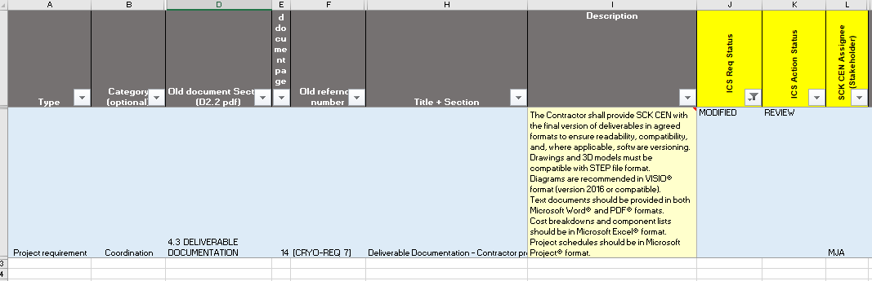
Control and Interface Requirement
Requirements update for Granting Phase
Requirements Update
Control Architecture Update?
Deliverables required (conceptual design) for Controls
Interface CCS, MCS
Concentrator on side of MCS
Test Plan, Milestones, Integration Input

Slide 14
Changed – 1 Concentrator Description

Slide 15
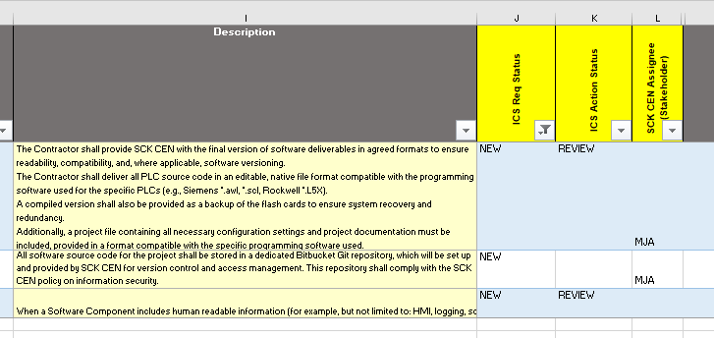
New = 3

Slide 16
New = 3

Slide 17
Copyright © SCK CEN
PLEASE NOTE!
This presentation contains data, information and formats for dedicated use only and may not be communicated, copied, reproduced, distributed or cited without the explicit written permission of SCK CEN. If this explicit written permission has been obtained, please reference the author, followed by ‘by courtesy of SCK CEN’.
Any infringement to this rule is illegal and entitles to claim damages from the infringer, without prejudice to any other right in case of granting a patent or registration in the field of intellectual property.
SCK CEN
Belgian Nuclear Research Centre
Foundation of Public Utility
Registered Office: Avenue Herrmann-Debrouxlaan 40 – BE-1160 BRUSSELS
Operational Office: Boeretang 200 – BE-2400 MOL

